Slide 2
Alignments files

Slide 3
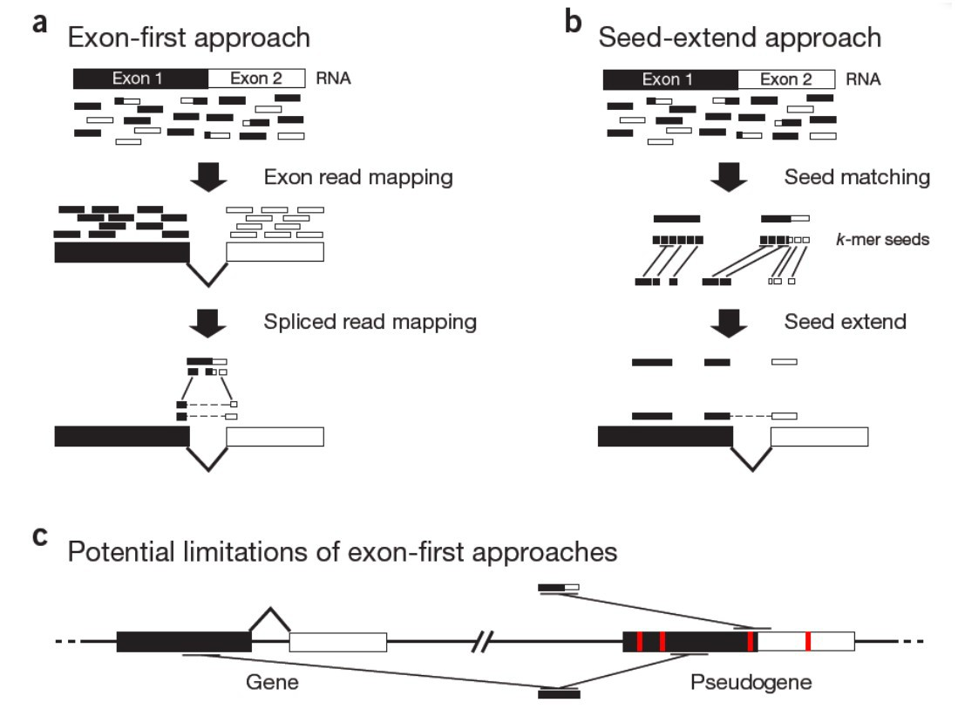
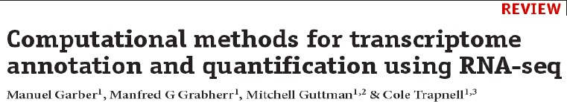
Exon first vs seed extend

Slide 4
Read alignments files: the BAM/SAM format
BAM is the Binary equivalent of SAM (which is plain text) In practice: we essentially use BAM files
‘Sequence Alignment/Map’ format
http://samtools.sourceforge.net/SAMv1.pdf
Supported by all major alignment packages.
SAM/BAM files an be manipulated with SAMtools (and others)
Header section:
Metadata about the genome, the samples, the pipeline
Header lines start with @
Alignments (or ‘records’) section:
6_1303_10584_85775 | 99 | groupVIII | 311 | 3 | 63M3I34M | = | 780 | 572 | GGGTATTGGGC @CFFFFFHFH
6_1111_20943_90813 | 163 | groupVIII | 315 | 40 | 100M | = | 809 | 594 | TAATGAAGCCAT @BDDFDDA+<A<
6_2111_2016_88235 | 355 | groupVIII | 315 | 3 | 100M | = | 856 | 573 | TAATGAAGCCAT @?DADDBD>D>B
6_1104_8139_99999 | 163 | groupVIII | 316 | 14 | 100M | = | 818 | 602 | AATGAAGCCATT @@FFFFFGHGHH
6_1304_4167_91751 | 163 | groupVIII | 322 | 5 | 52M3I29M | = | 812 | 573 | GCCATTTTTAC <<BDBDEHHDF
6_2301_14383_16382 | 163 | groupVIII | 323 | 40 | 51M3I46M | = | 809 | 589 | CCATTTTTACT CCFFFFFHHHH

Slide 5
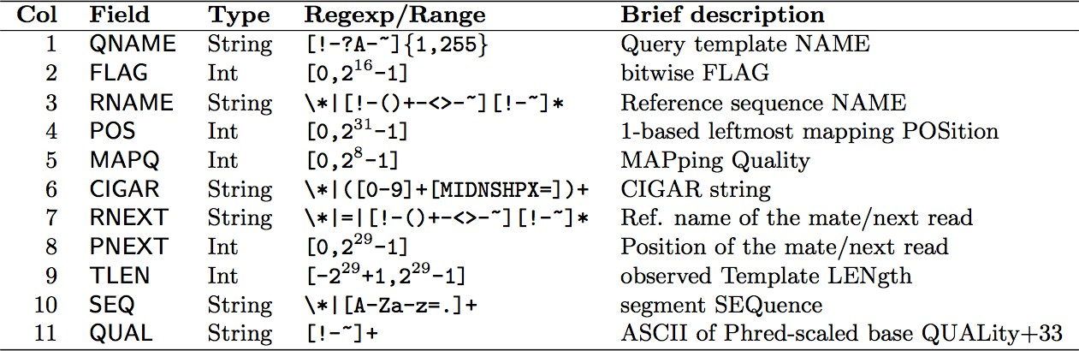
SAM alignment section
cf. FASTQ format
Read Name FLAG Chrom AlnStart CIGAR Sequence BaseQuals
6_1303_10584_85775 | 99 | groupVIII | 311 | 3 | 63M3I34M | = | 780 | 572 | GGGTATTGGGC @CFFFFFHFH
6_1111_20943_90813 | 163 | groupVIII | 315 | 40 | 100M | = | 809 | 594 | TAATGAAGCCAT @BDDFDDA+<A<
6_2111_2016_88235 | 355 | groupVIII | 315 | 3 | 100M | = | 856 | 573 | TAATGAAGCCAT @?DADDBD>D>B
6_1104_8139_99999 | 163 | groupVIII | 316 | 14 | 100M | = | 818 | 602 | AATGAAGCCATT @@FFFFFGHGHH
6_1304_4167_91751 | 163 | groupVIII | 322 | 5 | 52M3I29M | = | 812 | 573 | GCCATTTTTAC <<BDBDEHHDF
6_2301_14383_16382 | 163 | groupVIII | 323 | 40 | 51M3I46M | = | 809 | 589 | CCATTTTTACT CCFFFFFHHHH

Slide 6
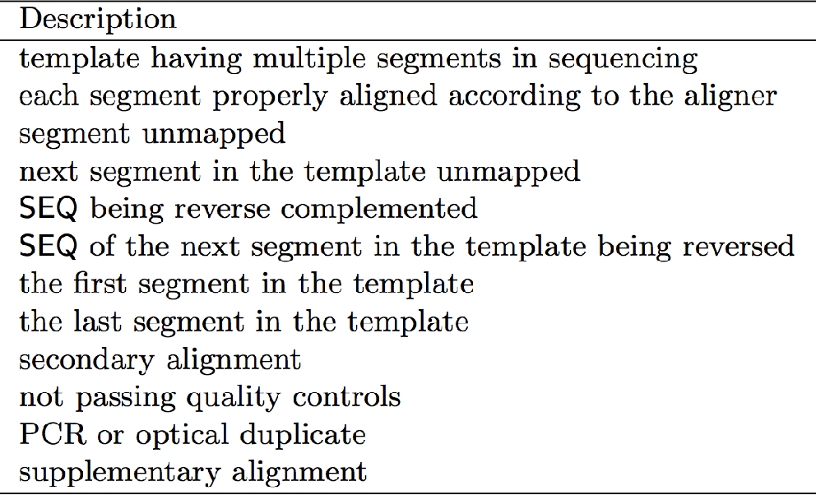
SAM flags
Base 16
Base 10
Base 2
00000000 | 00000001
00000000 | 00000010
00000000 | 00000100
00000000 | 00001000
00000000 | 00010000
00000000 | 00100000
00000000 | 01000000
00000000 | 10000000
00000001 | 00000000
00000010 | 00000000
00000100 | 00000000
00001000 | 00000000
0x1 | 1
0x2 | 2
0x4 | 4
0x8 | 8
0x10 | 16
0x20 | 32
0x40 | 64
0x80 | 128
0x100 | 256
0x200 | 512
0x400 | 1024
0x800 | 2048
₂0
₂1
₂2
₂3
₂4
₂5
₂6
₂7
₂8
₂9
₂10
₂11
SAM flags are displayed in base 10 (decimal) but only have a meaning when converted to binary numbers
You can decode them with samtools flags:
samtools flags 163
# 0xA3 163 PAIRED,PROPER_PAIR,MREVERSE,READ2

Slide 7
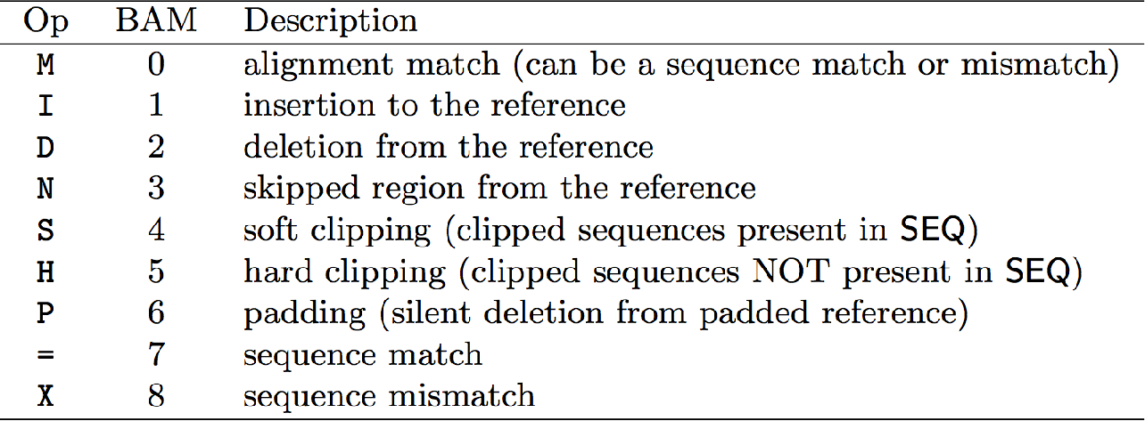
‘CIGAR strings’ (Alignments)
6_1303_10584_85775 | 99 | groupVIII | 311 | 3 | 63M3I34M | = | 780 | 572 | GGGTATTGGGC @CFFFFFHFH
6_1111_20943_90813 | 163 | groupVIII | 315 | 40 | 100M | = | 809 | 594 | TAATGAAGCCAT @BDDFDDA+<A<
6_2111_2016_88235 | 355 | groupVIII | 315 | 3 | 100M | = | 856 | 573 | TAATGAAGCCAT @?DADDBD>D>B
6_1104_8139_99999 | 163 | groupVIII | 316 | 14 | 100M | = | 818 | 602 | AATGAAGCCATT @@FFFFFGHGHH
6_1304_4167_91751 | 163 | groupVIII | 322 | 5 | 52M3I29M | = | 812 | 573 | GCCATTTTTAC <<BDBDEHHDF
6_2301_14383_16382 | 163 | groupVIII | 323 | 40 | 51M3I46M | = | 809 | 589 | CCATTTTTACT CCFFFFFHHHH
100M — 100 matching nucleotides (i.e. no gaps)
63M-3I-34M — 63 matching nucleotides
3 nucleotides not in the reference (3bp insertion) 34 matching nucleotides
Aligned Read
TGCAGGATGGATGTGTTCCTCCTCAGCTGCTTATTTTAACTCCACTGCACAACATGTTTTGTGTTATATTCTTTCGCTGTGTAGTCTGTAAGC
TGCAGGGACTGCAGGATGGATGTGTTCCTCCTCAGCTGCTTATTTTAACTCCAC---ACAACATGTTTTGTGTTATATTCTTTCGCTGTGTAGTCTGTAAGCAGAGTATGATACTG
Reference

Slide 8
The SAMtools program
samtools <subprogram>
Major SAMtools subprograms and options:
view [options] <file>
[options]
Default: converts to ‘beheaded’ SAM;
-H: output the SAM header, -h: convert to full SAM, -b: leave in (or
convert to) BAM format
-f/-F <int>: filter for/against flags matching the integer.
e.g. -F 0x904 removes all records flagged 0x4 (unmapped), 0x100 (secondary) or 0x800 (supplementary).
If file is - (hyphen) STDIN is used
sort <file> — Sorts the alignments within a BAM file (ie. by chromosome
and coordinate). If file is - (hyphen) STDIN is used.
index <file> — Creates an index file (.bai) for the given (sorted) BAM file
faidx <file> — Creates an index file (.fai) for the given FASTA file
flags <integer> — Print the meaning(s) of the given flag.
flagstats <file> — Print statistics on the alignments in the BAM file.

Slide 9
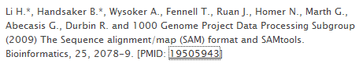
Sequence alignment and map
– SAM (Sequence Alignment/Map) format:
●
Capture all of the critical information about NGS data in a single indexed and compressed file
Sharing : data across and tools Generic alignment format
●
●
SAMTOOLS: provide various
utilities for manipulating alignments in the SAM format:sorting, merging, indexing...
http://samtools.sourceforge.net/ http://picard.sourceforge.net/explain-flags.html
●

Slide 10
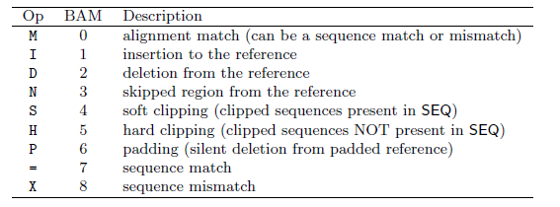
Spliced cigar line
–
Extend CIGAR strings
–
Example: intron de 81 bases
ERR022486.8388510 81 22 32099 255 58M81N18M = 27484 -4772 CCTTGGTCTTGCCGAAGTAGATCTCATTGAGAGTGGAGCGGATCTTGTTCTCCATTTCCTCCA CCAGGCGTCCGAT :9=<==;<<><=><?>>?<?==>>?>><?>>??<AA? @AFADDD;GDGAG@GGCBE@GG?GG>GGGG?GGGGGGGG NM:i:0 XS:A:- NH:i:1

Slide 11
Bam & Bed
– BAM (Binary Alignment/Map) format:
Compressed binary representation of SAM
Greatly reduces storage space requirements to about 27% of original SAM
Bamtools: reading, writing, and manipulating BAM files
●
●
– Bed (Browser Extensible Data) format:
tab-delimited text file that defines a feature track http://genome.ucsc.edu/FAQ/FAQformat.html#format1 The first three required BED fields are:
<chromosome> <start> <end> 9 additional optional BED fields
●
●

Slide 12
Aligning reads to a genome (using STAR)
Make sure the commands work. (hypens; updated paths, matching sample names…)
Provide any new files for the day (eg. trimmed files…)!
Check file permissions!

Slide 13
Using STAR to align reads
Assuming a previously built STAR genome index!

Slide 14
STAR genome index (database)
Created from the FASTA & GTF files downloaded from Ensembl
Commands:
module load STAR
fasta_file=./Mus_musculus.GRCm38.dna_sm.primary_assembly.fa gtf_file=./Mus_musculus.GRCm38.98.gtf
mkdir star_db
STAR \
--runMode genomeGenerate \
--genomeFastaFiles $fasta_file \
--sjdbGTFfile $gtf_file \
--genomeDir ./star_db/
Submitted as a grid job with 92G memory
Already done!!
The STAR genome database is in:
/u/project/scampbel/nrochett/GENOMES/m38p6.M22/e98/star_db

Slide 15
Using STAR to align reads
The (previously built) STAR genome index is in:
/u/project/scampbel/nrochett/GENOMES/m38p6.M22/e98/star_db
On the cluster:
module load STAR module load samtools # STAR -h | less
sample=P10_rep1 star_db_dir=/u/project/scampbel/nrochett/GENOMES/m38p6.M22/e98/star_db
STAR \
--genomeDir $star_db_dir \
--readFilesIn $sample.five_percent.trimmo.fastq.gz \
--readFilesCommand zcat \
--outFileNamePrefix $sample. \
--outSAMtype BAM SortedByCoordinate \
--outFilterMismatchNmax 5 \
--outFilterMultimapNmax 1

Slide 16
Assessing read alignments !
Percentage of reads that successfully aligned: typically >80% for human/mouse references
Outcome differences between samples (quality outliers and/or batch effects)
If paired-end sequencing: Percentage of pairs that co-align (‘properly paired’ statistics)
Dedicated quality-control tools exist:
RSeQC (Wang et al. 2012)
QoRTs (Hartley&Mullikin2015)

Slide 17
Multiqc
Tells when report was generated and the data folder used to generate the report
There will be multiple tools used to generate the final report
Notes:
Similar layout and can be used in a similar way

Slide 18
General statistics
Key statistics from ALL modules are found
Feature counts, STAR, FASTQC
Can see everything lined up together in one place

Slide 19
Now if you begin scrolling down will see more plots
Stacked bar plot
Click and unclick categories
Line graph with samples
All plots can be exported
Change size
Png vs svg (for publications vs powerpoint presentations)
Highlight samples using MULTIQC toolbox
Rename samples

Slide 20
Generate comprehensive multiqc report
Need to run in the directory that contains all .log files for all programs run

Slide 21
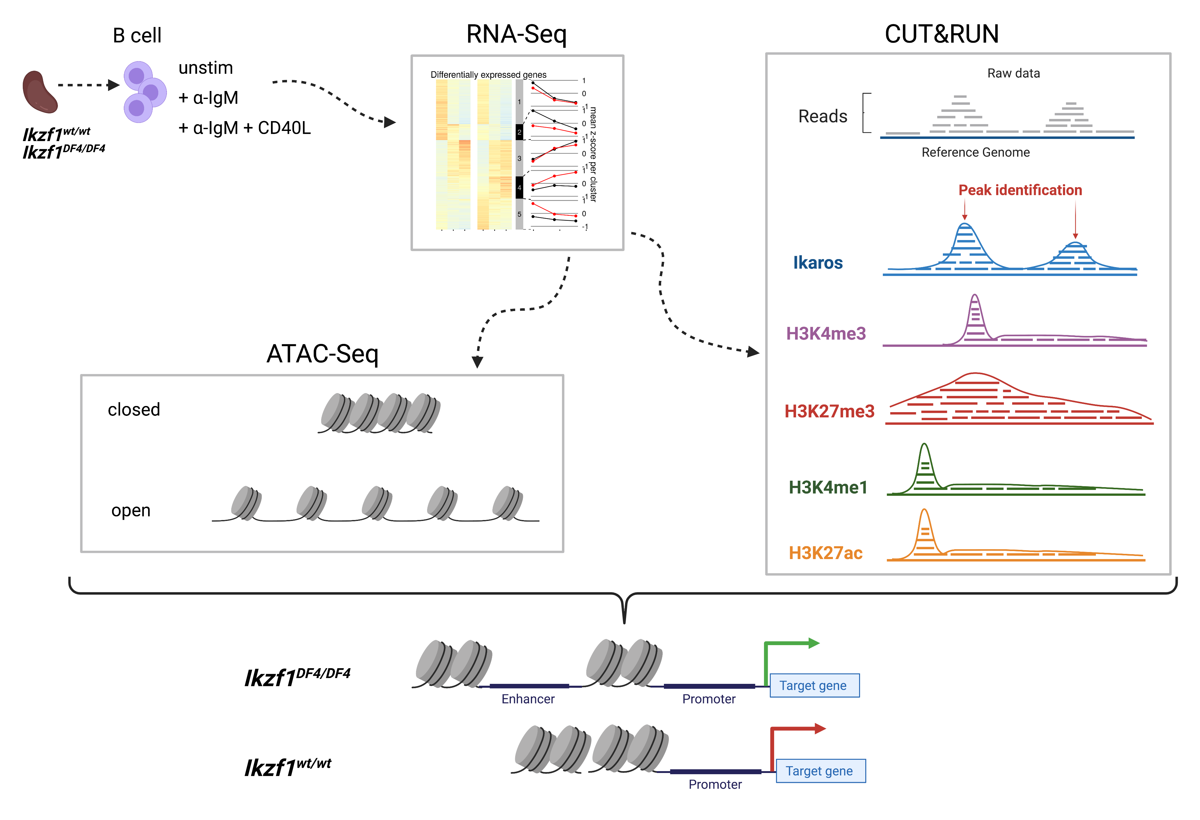
Functional Genomic Assays & Experimental Design
6 hrs
What genes are altered?
Which ‘targets’ are PTM?
Which regions of the chromatin are accessible?
Notes:
To identify and tease apart a potential mechanism carried out by a transcription factor requires an understanding of the chromatin organization and PTMs present in the genome which may contribute to alterations in gene transcription. As such, it was essential for us to use techniques that could detect these changes or modifications. Here we are using WT or Ikaros-mutated B cells that have been either left unstimulated, or stimulated with signal one alone, or with signal 1 and 2 for 6 hrs for our downstream functional genomics assays. These include RNAseq which allowed us to ask questions about alterations in gene transcription. ATAC sequencing, which gave us the ability to understanding differences in the chromatin landscape and Finally, CUT&RUN which allowed us to survey genome-wide the presence of Ikaros and other histone marks in both cell types with a half a million cells. Together, this information allowed us to understand differences in epigenetic regulation which led to the transcription of genes that should normally not be expressed prior to receiving costimulatory signal.

Slide 22
Functional Genomic Assays
Notes:
Ikaros regulates the responses to antigen through epigenetic regulation of target genes which are required for costimulatory signal activation in mature B cells. In the event of a loss-of-function mutation (Ikzf1^{ΔF4/ΔF4}), Ikaros is no longer able to regulate gene expression

Slide 23
Experimental Design
Ikaros-mutant
CUT&RUN
6hrs - ‘early’ time point
Signal one = anti-IgM
Signal two = CD40L

Slide 24
RNA-seq: Displaying >18,000 genes on principal component analysis (PCA)
Genes are clustering by ex-vivo stimulation
Genes also cluster by genotype

Slide 25
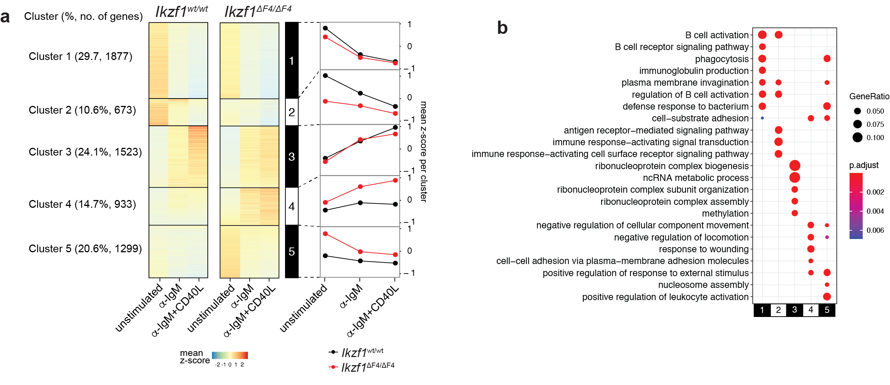
Comparison of WT and Ikzf1^{ΔF4/ΔF4} B cells transcriptional changes
There is a large subset of genes are de-repressed at baseline
Notes:
Upon performing RNA-sequencing, we were able to identify ~5000 deregulated genes which were altered in WT and IKaros mutated B cells with and without stimulation. These altered genes were grouped into 5 different clusters to highlight both similarities in responses to BCR crosslinking and costimulatory signal but also the differences between the cell types. I hope you can appreciate that responses to stimulation are similar shown in clusters 1 and 3. But there are other clusters such as cluster 5, which makes up a quarter of the altered genes and are just highly expressed in Ikaros mutated cells and belong to pathways involved in the ‘positive regulation of leukocyte activation’ as ‘response to external stimulus’.

Slide 26
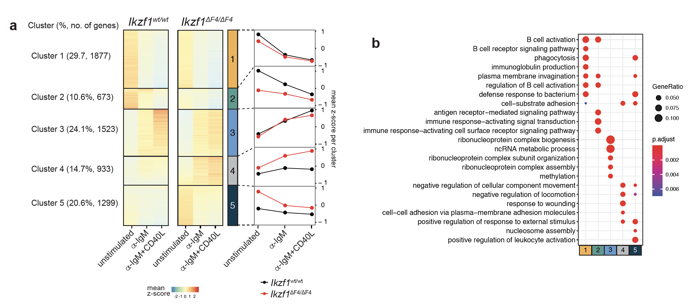
Transcriptome analysis identified a large subset of genes that are de-repressed at baseline
Our next step was to investigate the
altered chromatin landscape

Slide 27
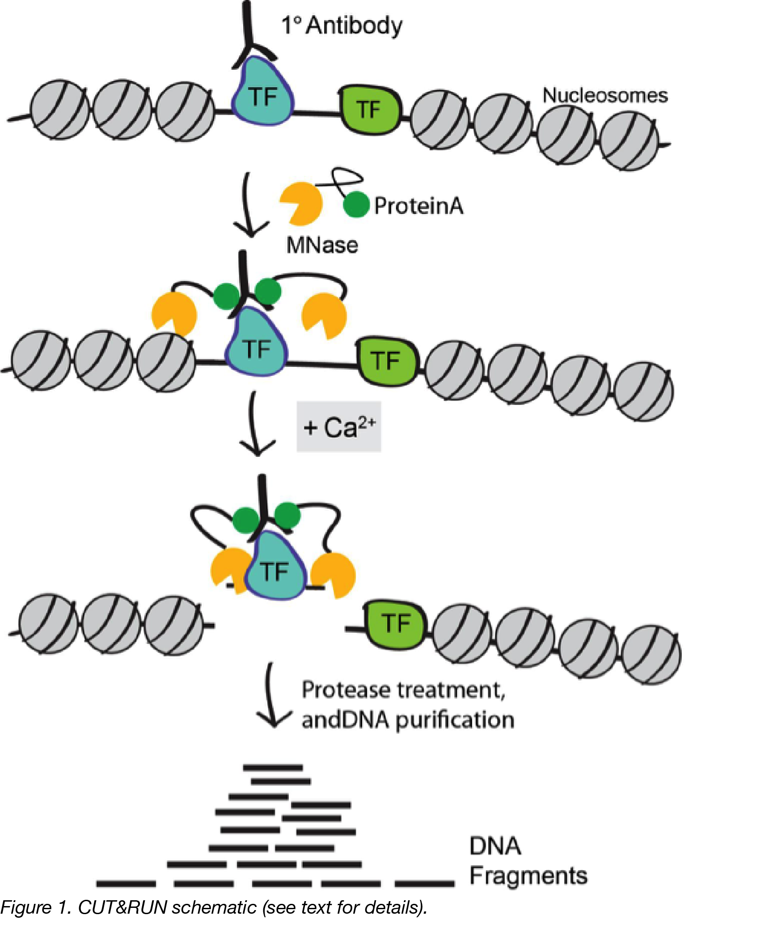
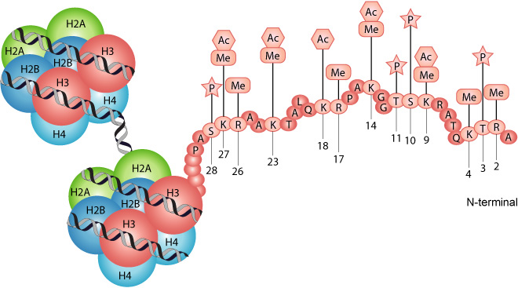
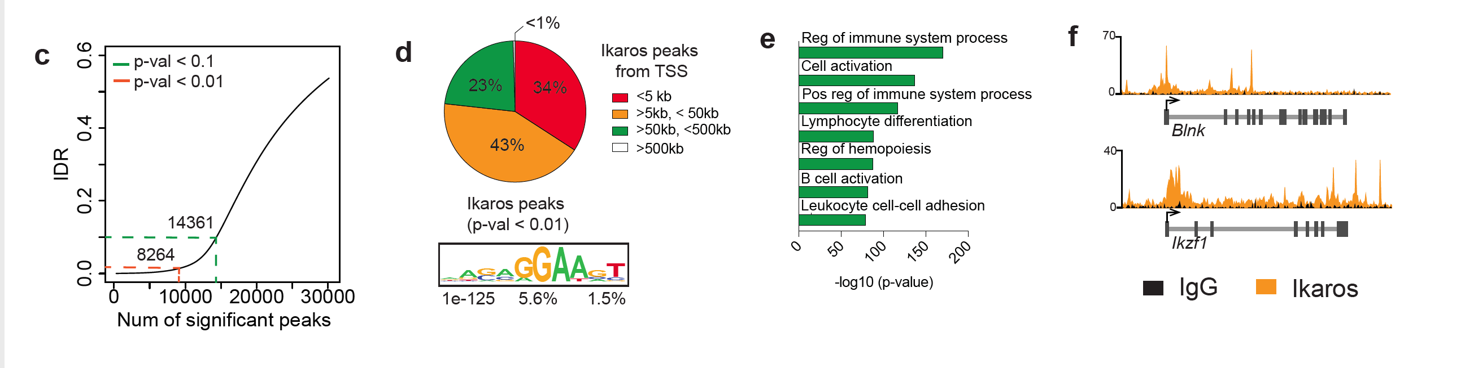
CUT&RUN was used to study various targets including histone PTM and other protein/DNA interactions
Notes:
Next, we performed CUT&RUN to map both Ikaros binding sites and to study changes in histone PTM which can correspond with gene expression. There are at least nine different types of histone modifications have been discovered. In my work we focus on acetylation & methylation which can be associated with enhancers or promoters of active or repressed genes.

Slide 28
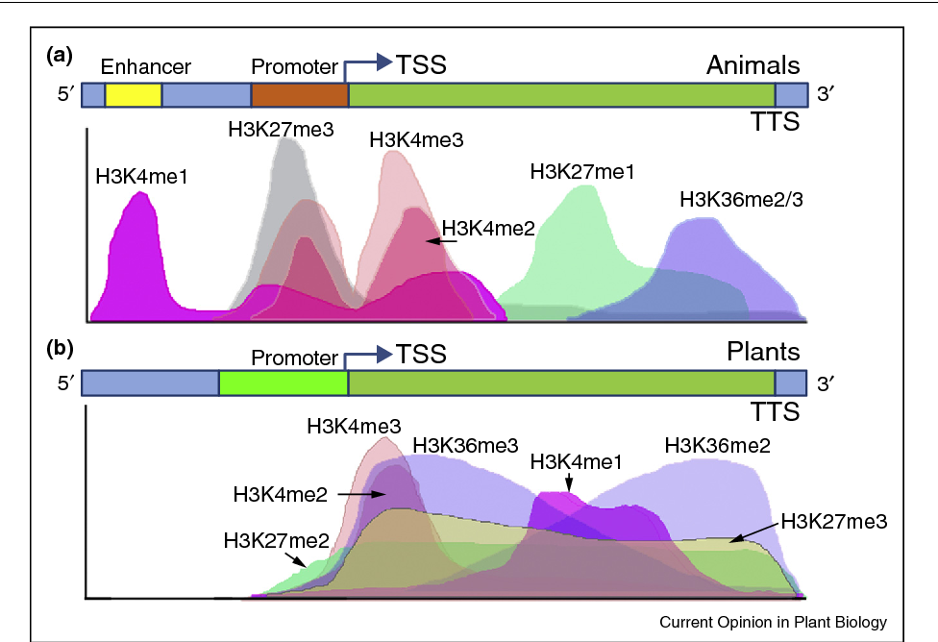
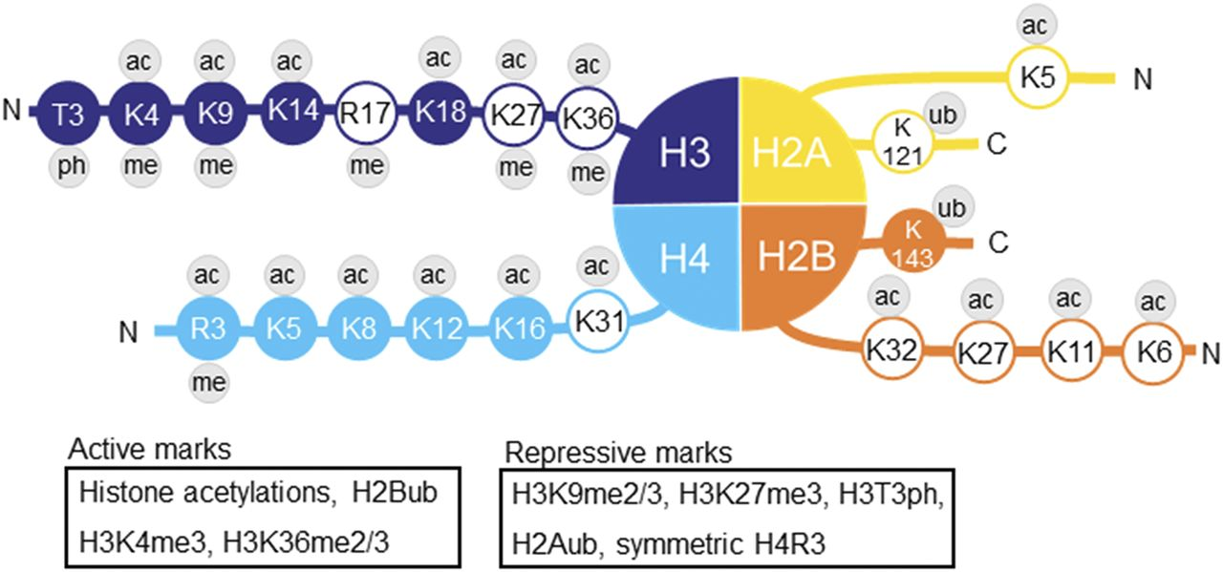
PTMs have different implications for gene transcription and are distributed at different regions across the gene
Histone proteins undergo post-translational modification (PTM) which impacts their interactions with DNA
There are at least nine different types of histone modifications have been discovered. In my work we focus on acetylation & methylation
Notes:
Histone proteins undergo post-translational modification (PTM) which impacts their interactions with DNA. Some modifications disrupt histone-DNA interactions, & there are at least nine different types of histone modifications have been discovered. In my work we focus on acetylation & methylation. Each of these modifications are added or removed from histone amino acid residues by a specific set of enzymes. Acetylation is one of the most widely studied histone modifications and is known to influence transcriptional regulation. Acetylation adds a negative charge to lysine residues on the N-terminal histone tails which results in a relaxed chromatin structure. The open chromatin conformation allows transcription factor binding and significantly increases gene expression. Acetylation of K9 and K27 on histone H3 (H3K9ac and H3K27ac) is usually associated with enhancers and promoters of active genes. while lysine methylation is implicated in both transcriptional activation and repression depending on the methylation site. For example, both mono- and tri-methylation on K4 of histone H3 (H3K4me1and H3K4me3) are activation markers, but with unique nuances: H3K4me1 typically marks transcriptional enhancers, while H3K4me3 marks gene promoters.

Slide 29
CUT&RUN was used to study various targets including histone PTM and other protein/DNA interactions

Slide 30
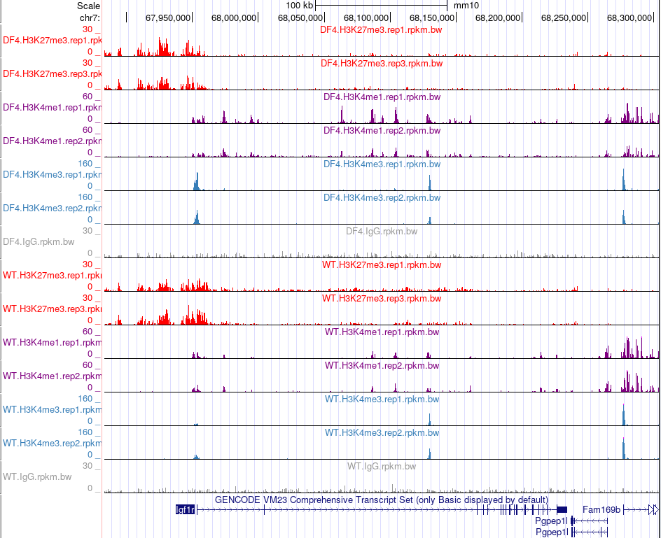
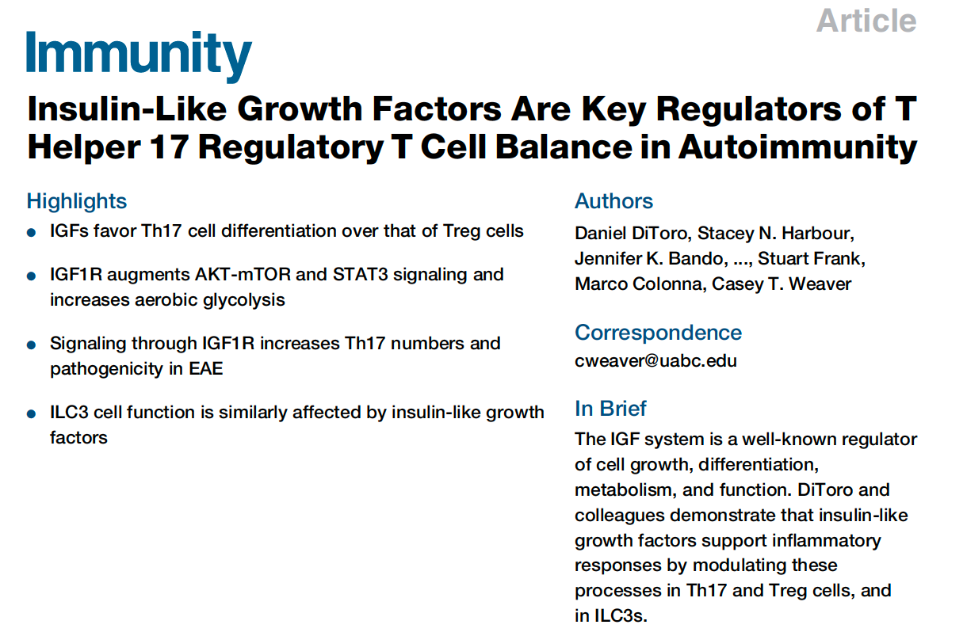
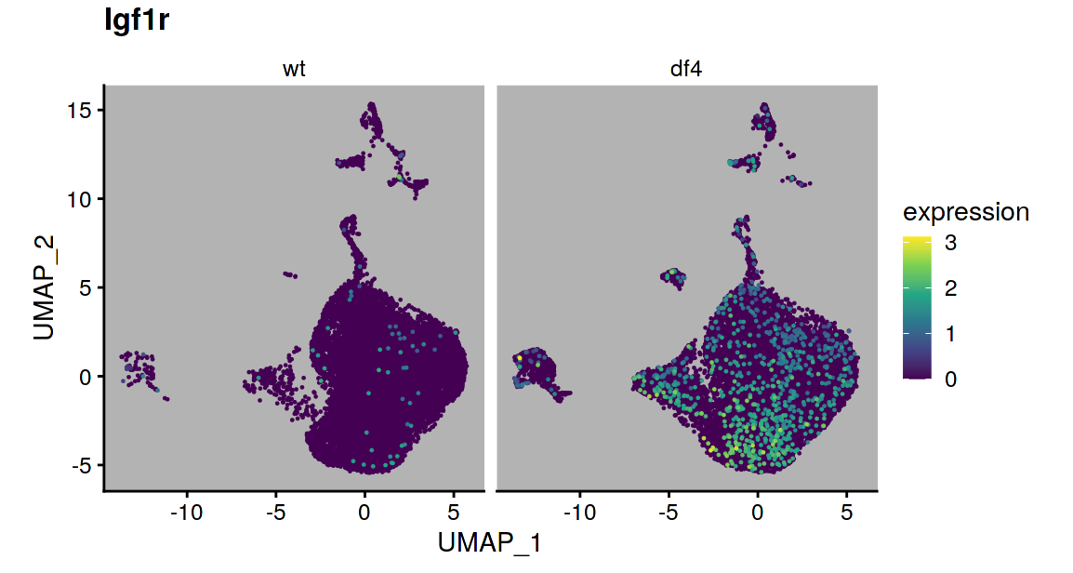
IGF1R
H3K27me3
H3K4me1
H3K4me3
IKAROS-mutant
wildtype

Slide 31
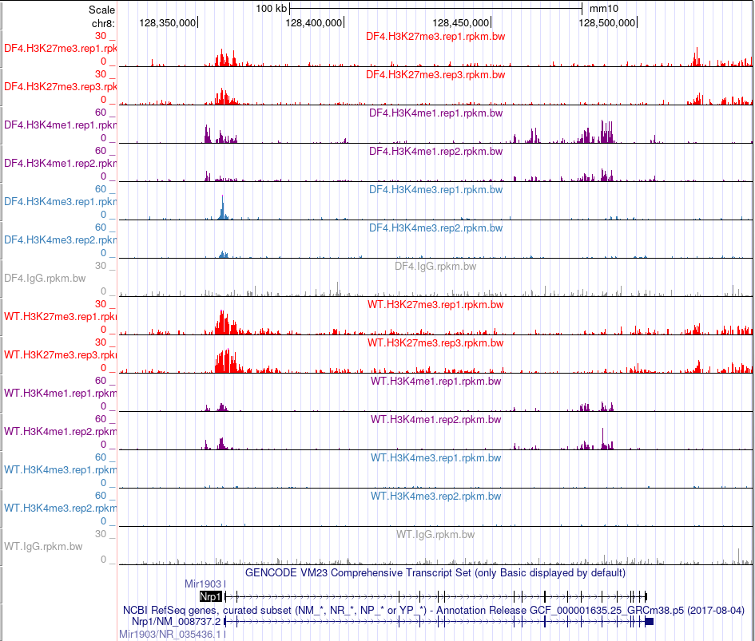
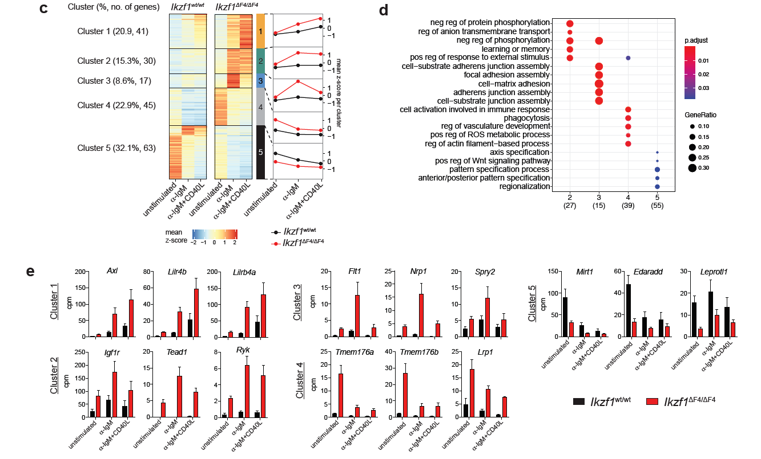
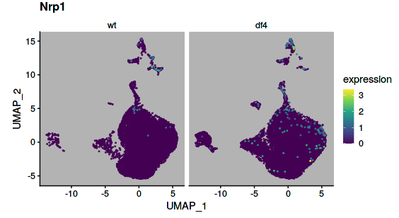
NRP1
H3K27me3
H3K4me1
H3K4me3
IKAROS-mutant
wildtype

Slide 32
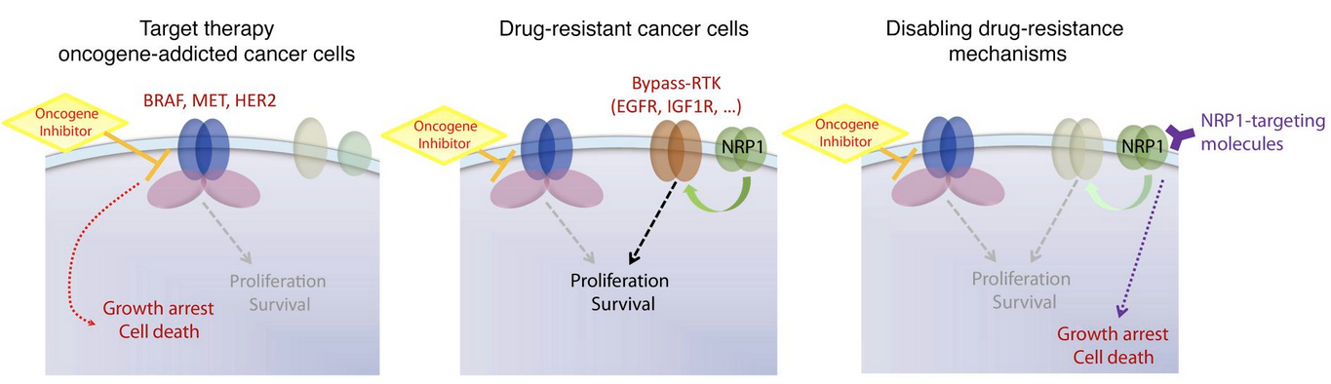
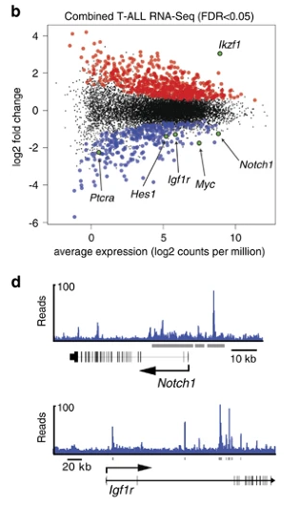
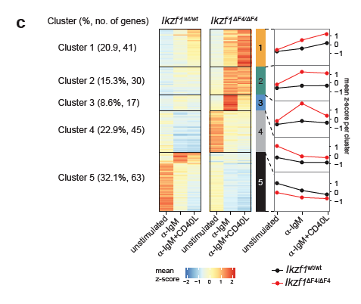
PMID: 29953416
Mechanistically, NRP1 induced a JNK-dependent signaling cascade leading to the upregulation of alternative effector
kinases EGFR or IGF1R, which in turn sustained cancer cell growth
Gene | Name | Cluster #
Igf1r | insulin-like growth factor 1 | 2
Nrp1 | Neuropilin 1 | 3
Ighg3 | Immunoglobulin Heavy Constant Gamma 3 (G3m Marker) | 4
Prox1 | Prospero Homeobox 1 | 4
Rnd3 | Rho Family GTPase 3 | 4
Tmem176a | Transmembrane Protein 176A | 4
Tmem176b | Transmembrane Protein 176B | 4
Trerf1 | Transcriptional Regulating Factor 1 | 4
Neurl3 | Neuralized E3 Ubiquitin Protein Ligase 3 | 5
Rapgef4 | Rap Guanine Nucleotide Exchange Factor 4 | 5
Cd27 | CD27 Molecule | 5
https://doi.org/10.1038/leu.2015.27

Slide 33
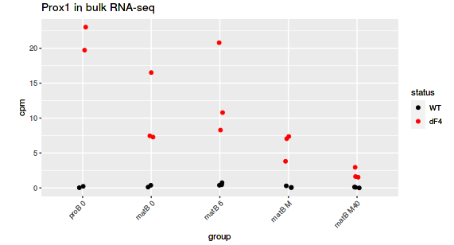
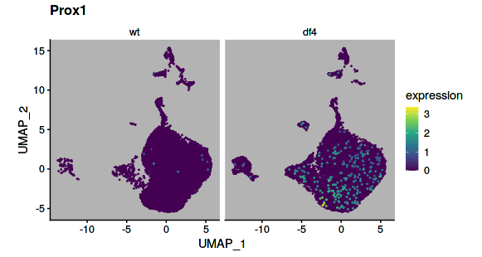
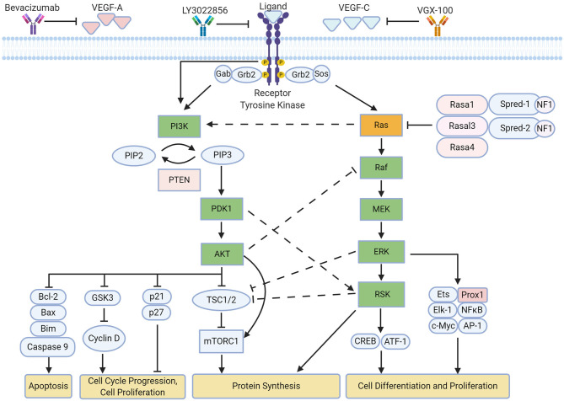
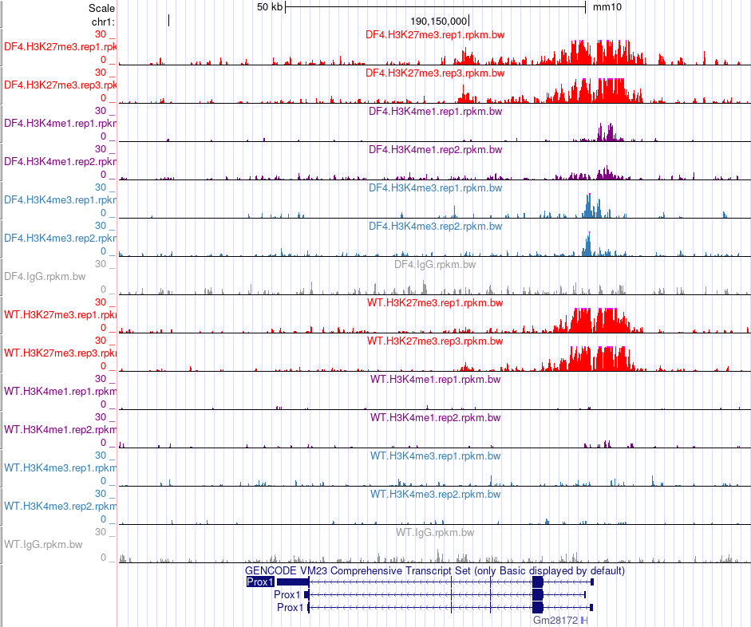
PROX1
IKAROS-mutant
wildtype

Slide 34
Summary
Ikzf1^{DF4/DF4} mice exhibit an autoimmune-like phenotype including, secretion of autoreactive antibodies from 5 weeks onwards.
Ikzf1^{DF4/DF4} B cells are capable of activation and proliferation with one signal alone.
The integration of transcriptome and chromatin analysis allowed us to identify a subset of developmentally regulated genes that fail to be silenced in Ikaros-mutated B cells.

